Slide 1
Automated Vehicles
By : Anwesh Mohanty

Slide 2
Introduction
Analysis
Future Prospects
Conclusion

Slide 3
Why Autonomous Vehicles
A substantial reduction in traffic jams
Increase in overall safety
Increase in productivity

Slide 4
Timeline
1788: James Watt designs the first governor
1945: invention of modern cruise control
1977: Tsukuba Mechanical Engineering Lab creates the first autonomous vehicle.

Slide 5
Timeline
1995: A vehicle created by UniBW drives from Munich to Copenhagen
2000’s : Various companies like Audi, BMW, Google enter the market.
2020’s : Automated vehicles to become mainstream

Slide 6
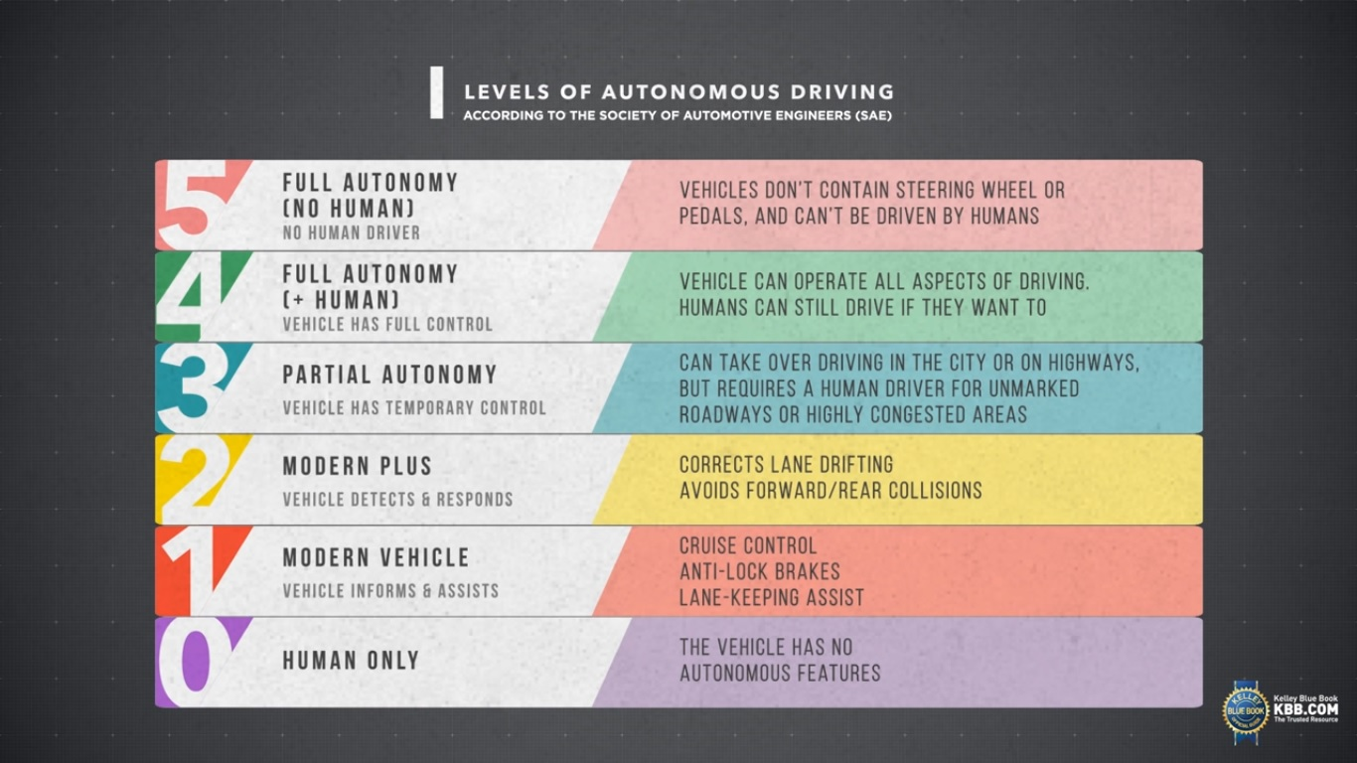

Slide 7
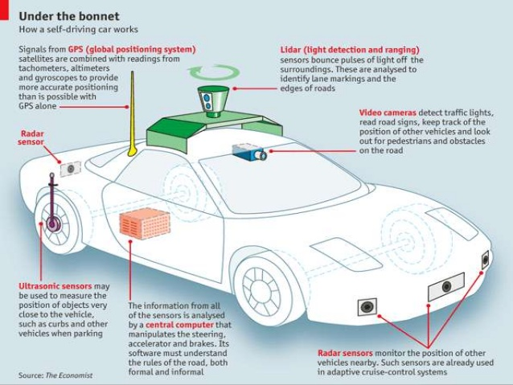

Slide 8
Components
Modifications to Existing Items
GPS Subsystems
LIDAR
Central Computer

Slide 9
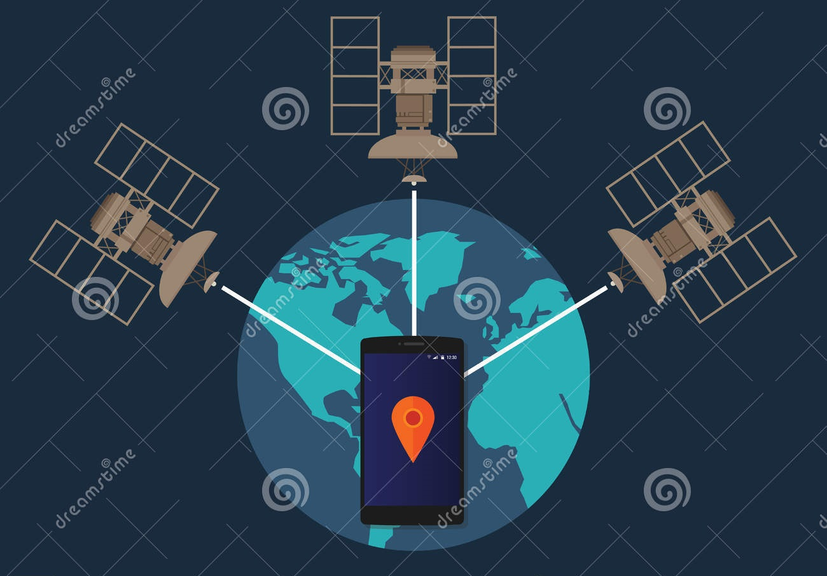
Global Positioning System

Slide 10
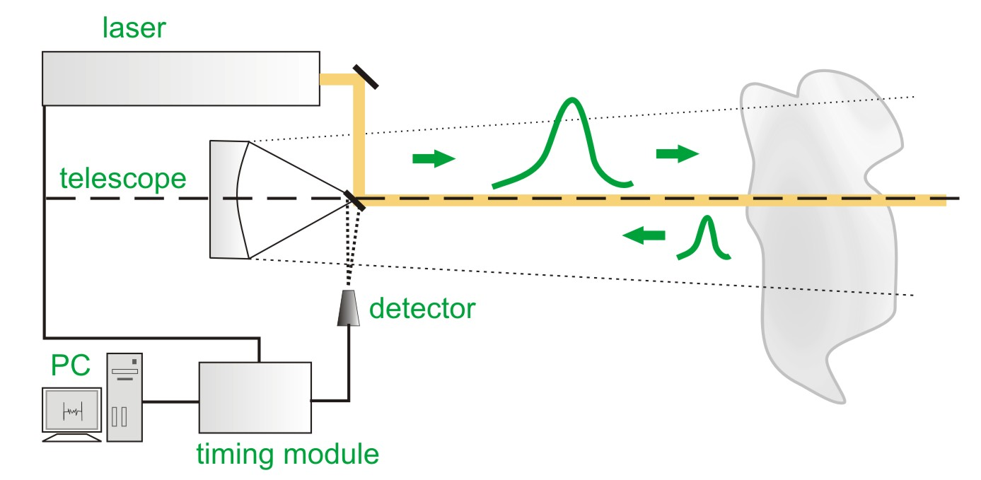
light detection and ranging system
Notes:
There are several major components to a lidar system:
Laser — 600–1000 nm lasers are most common for non-scientific applications. They are inexpensive, but since they can be focused and easily absorbed by the eye, the maximum power is limited by the need to make them eye-safe. Eye-safety is often a requirement for most applications. A common alternative, 1550 nm lasers, are eye-safe at much higher power levels since this wavelength is not focused by the eye, but the detector technology is less advanced and so these wavelengths are generally used at longer ranges and lower accuracies. They are also used for military applications as 1550 nm is not visible in night vision goggles, unlike the shorter 1000 nm infrared laser. Airborne topographic mapping lidars generally use 1064 nm diode pumped YAG lasers, while bathymetric systems generally use 532 nm frequency doubled diode pumped YAG lasers because 532 nm penetrates water with much less attenuation than does 1064 nm. Laser settings include the laser repetition rate (which controls the data collection speed). Pulse length is generally an attribute of the laser cavity length, the number of passes required through the gain material (YAG, YLF, etc.), and Q-switch speed. Better target resolution is achieved with shorter pulses, provided the lidar receiver detectors and electronics have sufficient bandwidth.[4]
Scanner and optics — How fast images can be developed is also affected by the speed at which they are scanned. There are several options to scan the azimuth and elevation, including dual oscillating plane mirrors, a combination with a polygon mirror, a dual axis scanner (see Laser scanning). Optic choices affect the angular resolution and range that can be detected. A hole mirror or a beam splitter are options to collect a return signal.
Photodetector and receiver electronics — Two main photodetector technologies are used in lidars: solid state photodetectors, such as silicon avalanche photodiodes, or photomultipliers. The sensitivity of the receiver is another parameter that has to be balanced in a lidar design.
Position and navigation systems — Lidar sensors that are mounted on mobile platforms such as airplanes or satellites require instrumentation to determine the absolute position and orientation of the sensor. Such devices generally include a Global Positioning System receiver and an Inertial Measurement Unit (IMU).

Slide 11
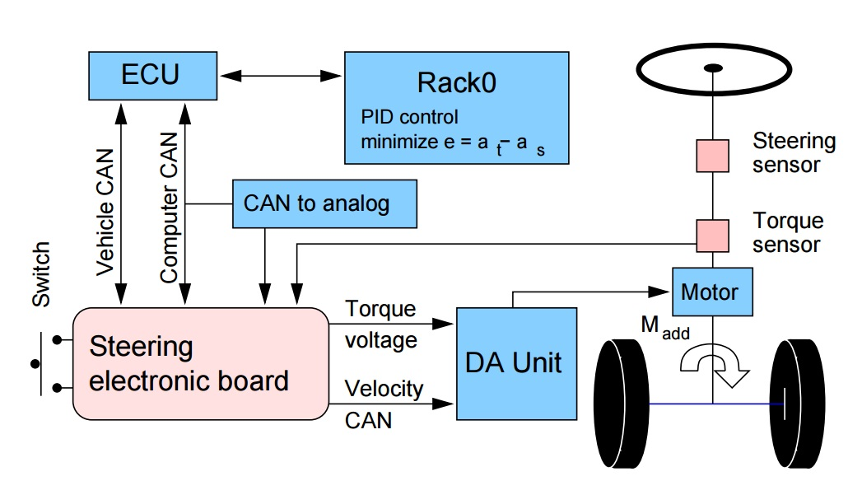
Steering System
Notes:
To provide a clean interface to the vehicle, we integrated an automotive ECU designed for highly reliable real-time applications. This ECU has four CAN(Controller Area network) interfaces as well as a wide variety of analog and digital I/O. In the vehicle, it is sitting between the computers on the one hand and the vehicle CAN bus and our actuators on the other hand. In this ECU, we implemented a state machine that allows us to enable different modes of operation (STOP, PAUSE and RUN) via wired buttons as well as by a wireless remote control. Besides these emergency buttons, the ECU handles timeouts in the command coming from the computers and ensures a safe vehicle state whenever those commands are missing.

Slide 12
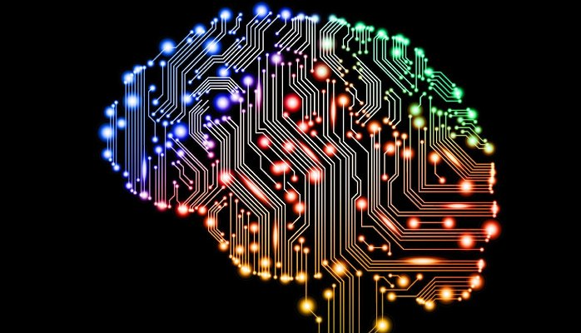
Machine Learning
Notes:
https://github.com/udacity/self-driving-car/blob/5f161c18c3861dc75ec8ea9b6fb3e285de12a262/steering-models/community-models/komanda/solution-komanda.ipynb

Slide 13
Advantages
Environmental
Safety
Time
Space

Slide 14
Thank You

